Slide 1
Generative Modelling
Lecture 1
Part 2
Generative AI for Computer Vision

Slide 2
Content
Generative Modelling
Synthetic Data Generation
Discriminative Learning
Generative Learning
Generative vs Discriminative Learning

Slide 3
Generative Modelling
Generative Modelling
  Generative Modelling is a branch of machine learning that focuses on learning the underlying probability distribution of data so that new, realistic samples can be generated.
  Suppose we have thousands of images of cats. A generative model learns the patterns, structure, and variations in those images.
  After training, it can create entirely new cat images that were never in the dataset.
  In contrast, a discriminative model learns to distinguish between categories (e.g., cat vs. dog) rather than generate new examples.
  In general generative models are unsupervised in nature.
  Learns the patterns of input data from a given distribution to generate new examples which belong to the similar distribution.

Slide 4

Generative Modelling
A generative model tries to learn the data distribution:
$P\left(X\right)$ or
the joint distribution:
$P\left(X,Y\right)$
where: X = input data, Y = labels (if available)
Once the distribution is learned, the model can sample new data points from it.

Slide 5
Why Synthetic Image Generation is required?
Supervised classification methods have achieved significant success in computer vision today, especially making a substantial progress in the era of deep learning.
But, Deep learning models require large accurately annotated image datasets for supervised learning.
Synthetic image generation is important in computer vision because collecting and labeling large amounts of real-world visual data is often expensive, slow, difficult, or sometimes impossible.
Synthetic data helps address these challenges by creating artificial images, videos, or sensor data that can be used to train and evaluate vision models.

Slide 6
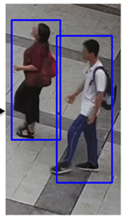
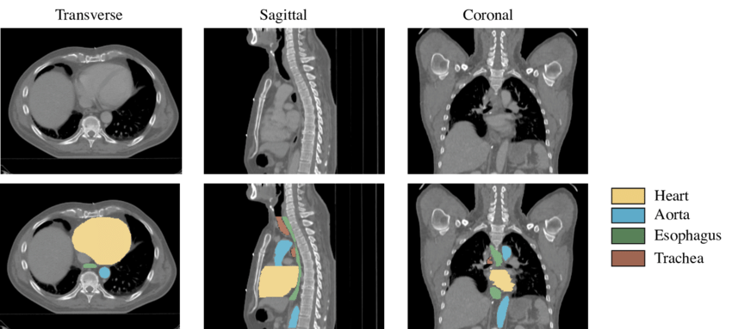
Why synthetic data is needed?
Reduces data collection costs: Gathering real images and annotating them can require thousands of hours of manual work. For example:
  Drawing bounding boxes around pedestrians in millions of frames.
  Labeling lane markings for autonomous driving.
  Segmenting organs in medical images.
Synthetic datasets can automatically generate labels during rendering, eliminating much of the annotation effort.
Image Source: Alfasly, Saghir & Liu, Beibei & Hu, Yongjian & Wang, Yufei & Li, Chang-Tsun. (2019). Auto-Zooming CNN-Based Framework for Real-Time Pedestrian Detection in Outdoor Surveillance Videos. IEEE Access.
Image Source: Trullo, Roger & Petitjean, Caroline & Dubray, Bernard & Ruan, Su. (2019). Multiorgan segmentation using distance-aware adversarial networks. Journal of Medical Imaging.

Slide 7
Why synthetic data is needed?
Provides perfect ground truth: When synthetic scenes are generated in a simulator, the exact Object locations, Object identities, Depth information, Surface normals, Segmentation masks, Camera poses are already known. This produces highly accurate labels that are difficult to obtain from real-world data.
Solves rare-event problems: Some important situations occur very infrequently in reality. Examples:
  Car accidents,
  Pedestrians suddenly crossing roads
  Industrial equipment failures
  Severe weather conditions
A synthetic environment can generate thousands of such scenarios, allowing models to learn from events that are rarely captured in real datasets.

Slide 8
Why synthetic data is needed
Improves diversity: Real datasets may contain biases:
  Certain geographic regions
  Weather conditions
  Lighting situations
  Demographics
Synthetic generation can systematically vary:
  Rain, fog, snow
  Time of day
  Camera viewpoints
  Object appearances
This helps models generalize better.

Slide 9
Why synthetic data is needed
Enables safe training for dangerous applications: Some situations are risky to collect in the real world. Examples:
  Autonomous vehicle crashes
  Military reconnaissance
  Disaster response robotics
  Drone emergency landings
Simulation allows these scenarios to be generated safely.
Supports domain adaptation: A common workflow is:
  Train on a large synthetic dataset.
  Fine-tune on a smaller real dataset.
This reduces the amount of real labeled data required while maintaining high performance.

Slide 10
Why synthetic data is needed
Helps when privacy is a concern: In domains such as:
  Healthcare
  Surveillance
  Retail analytics
real images may contain sensitive information.
Synthetic data can mimic the statistical properties of real data without exposing actual individuals.

Slide 11
Problems with Synthetic Data
Synthetic data is not a complete replacement for real data because of the simulation-to-reality (Sim2Real) gap.
Models trained only on synthetic images may struggle with:
  Real-world noise
  Sensor artifacts
  Unexpected object appearances
  Complex lighting effects
To reduce this gap, researchers use techniques such as:
  Domain randomization
  Photorealistic rendering
  Generative AI augmentation
  Fine-tuning with real-world samples

Slide 12
Learning Models
There are two types of learning models
  Discriminative Learning Model
  Generative Learning Model
A discriminative learning model is a machine learning model that learns by discrimination that means the boundary or relationship between input features and output labels. Instead of modeling how the data is generated, it directly learns to predict the target class from the observed data.
A generative learning model is a machine learning model that learns how the data is generated. Instead of only learning the relationship between inputs and labels, it learns the underlying probability distribution of the data.

Slide 13
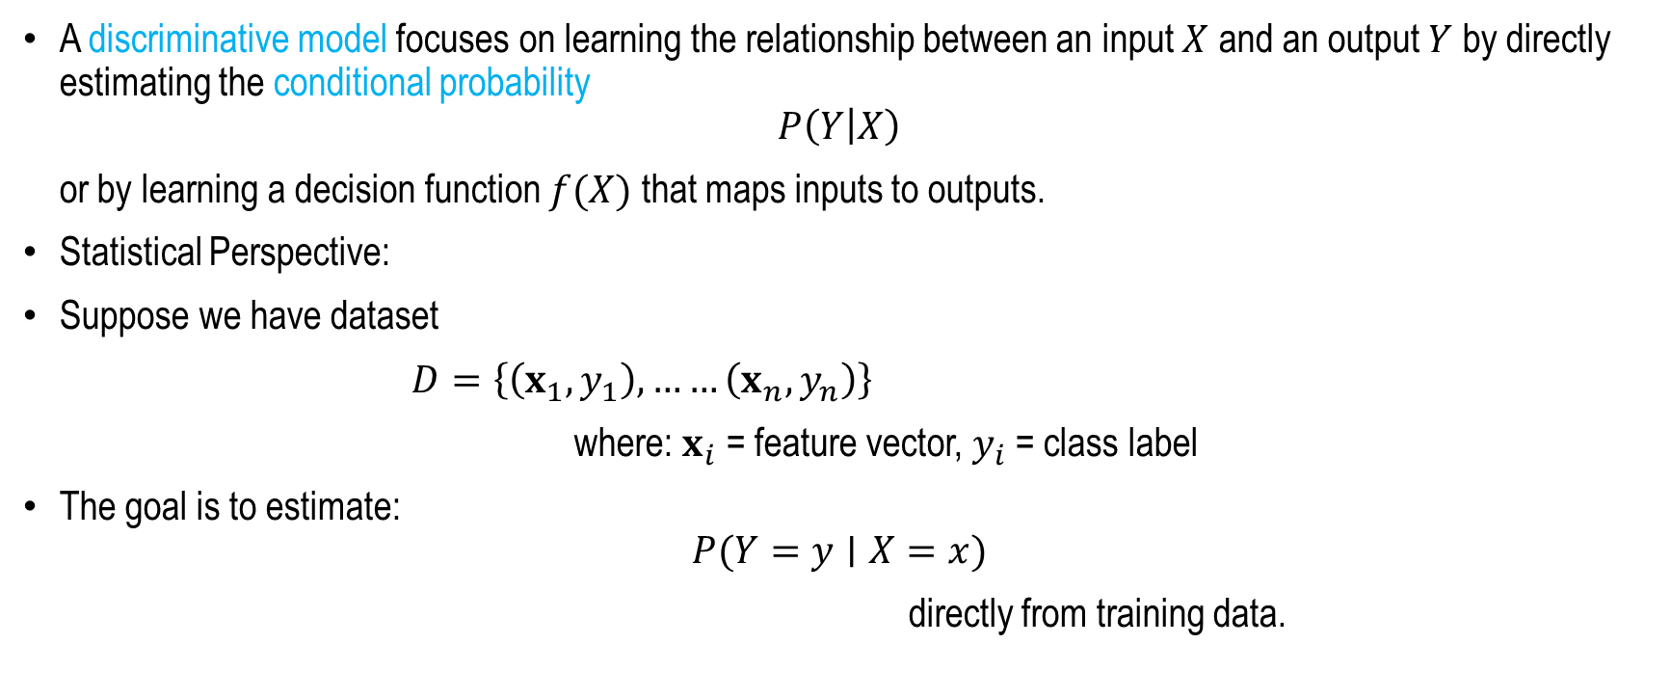
Discriminative Learning Model
A discriminative model focuses on learning the relationship between an input $X$ and an output $Y$ by directly estimating the conditional probability
$$P\left(Y | X\right)$$
or by learning a decision function $f(X)$ that maps inputs to outputs.
Statistical Perspective:
Suppose we have dataset
$D=\left\{\left(x_{1},y_{1}\right), ……\left(x_{n},y_{n}\right)\right\}$
where: $x_{i}$= feature vector, $y_{i}$= class label
The goal is to estimate:
$$P(Y=y∣X=x)$$
directly from training data.

Slide 14
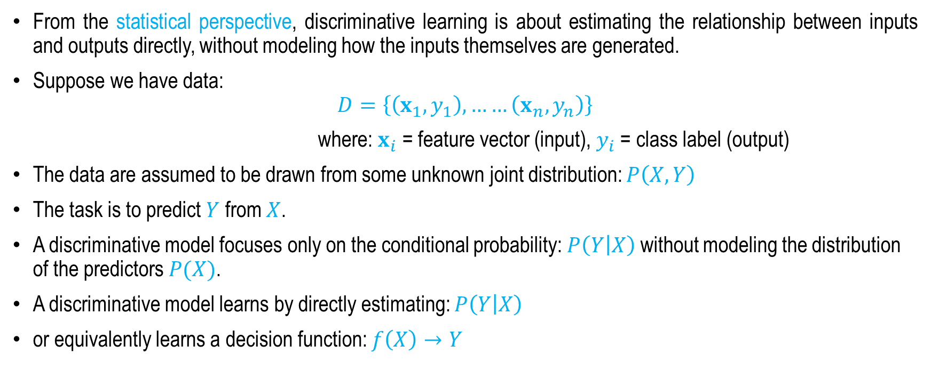
Discriminative Learning
Statistical Understanding
From the statistical perspective, discriminative learning is about estimating the relationship between inputs and outputs directly, without modeling how the inputs themselves are generated.
Suppose we have data:
$$D=\left\{\left(x_{1},y_{1}\right), ……\left(x_{n},y_{n}\right)\right\}$$
where: $x_{i}$= feature vector (input), $y_{i}$= class label (output)
The data are assumed to be drawn from some unknown joint distribution: $P\left(X,Y\right)$
The task is to predict $Y$ from $X$.
A discriminative model focuses only on the conditional probability: $P\left(Y | X\right)$ without modeling the distribution of the predictors $P(X)$.
A discriminative model learns by directly estimating: $P\left(Y | X\right)$
or equivalently learns a decision function: $f\left(X\right)→Y$

Slide 15
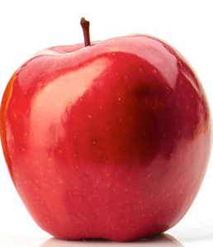

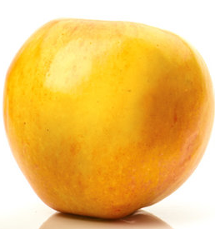


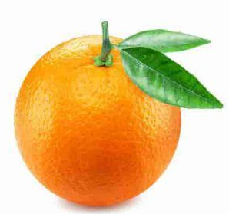
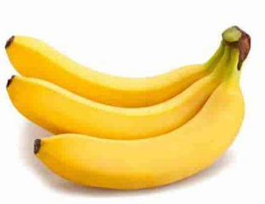

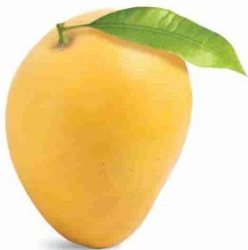
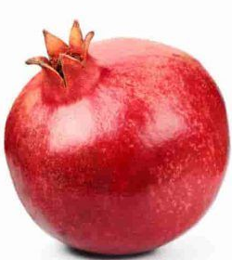
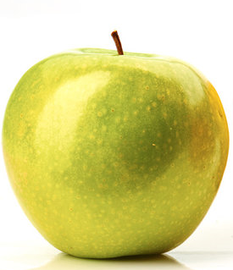
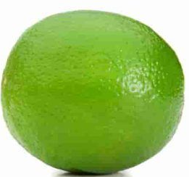
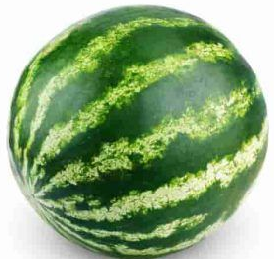
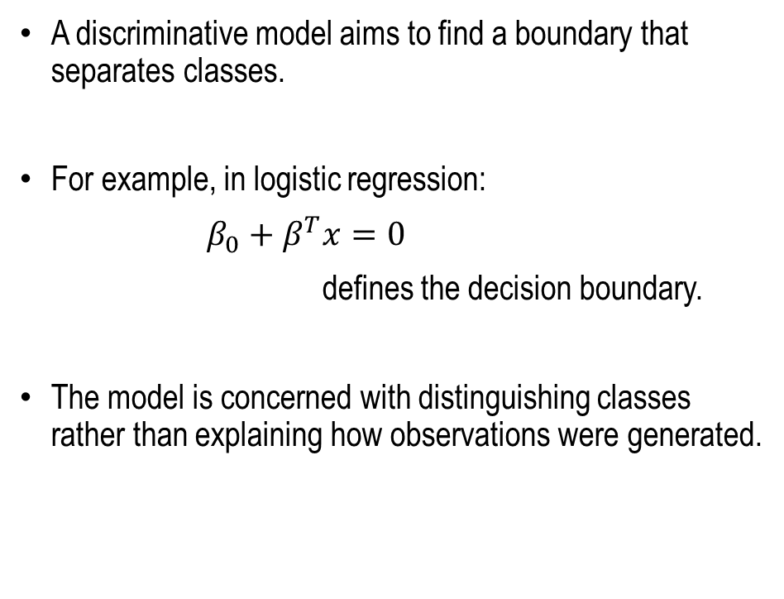
Logistic Regression
Decision Boundary
A discriminative model aims to find a boundary that separates classes.
For example, in logistic regression:
$β_{0}+β^{T}x=0$
defines the decision boundary.
The model is concerned with distinguishing classes rather than explaining how observations were generated.
Given this supervised classifier?
Two features
examples
What is ?
Weight
This is an Apple,
Decision Boundary
Size

Slide 16

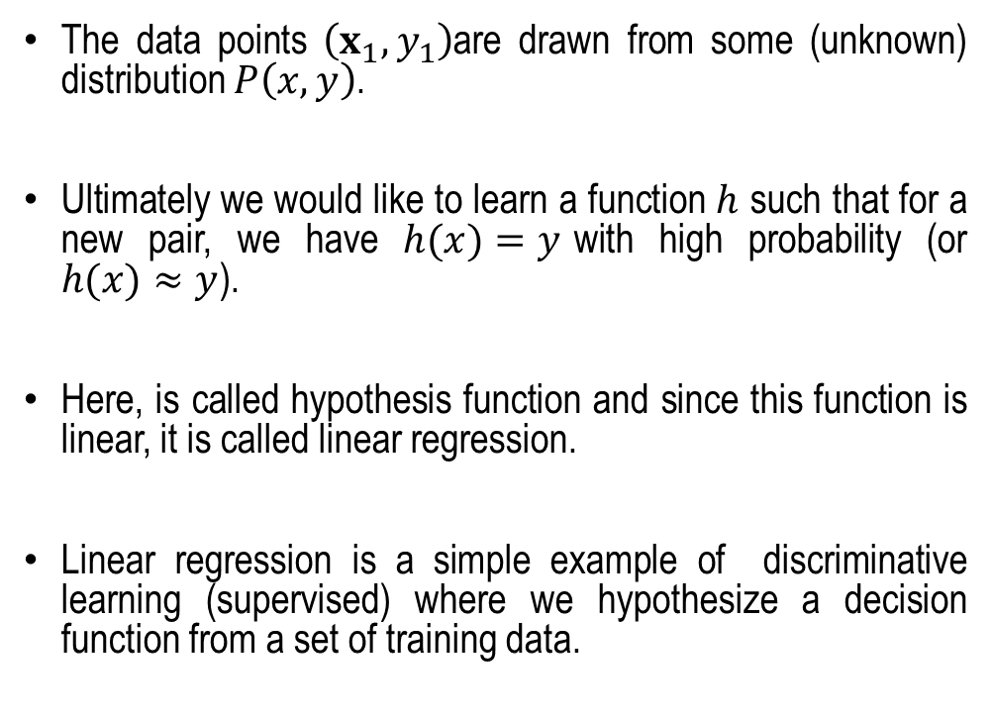


Linear Regression
The data points $\left(x_{1},y_{1}\right)$are drawn from some (unknown) distribution $P\left(x,y\right)$.
Ultimately we would like to learn a function $h$ such that for a new pair, we have $h(x)=y$with high probability (or $h(x)≈y$).
Here, is called hypothesis function and since this function is linear, it is called linear regression.
Linear regression is a simple example of discriminative learning (supervised) where we hypothesize a decision function from a set of training data.
$$h(x)$$
_{y6}
$$y$$
y₂
y₁
…
x₁
x₂
$$x$$
x₆

Slide 17
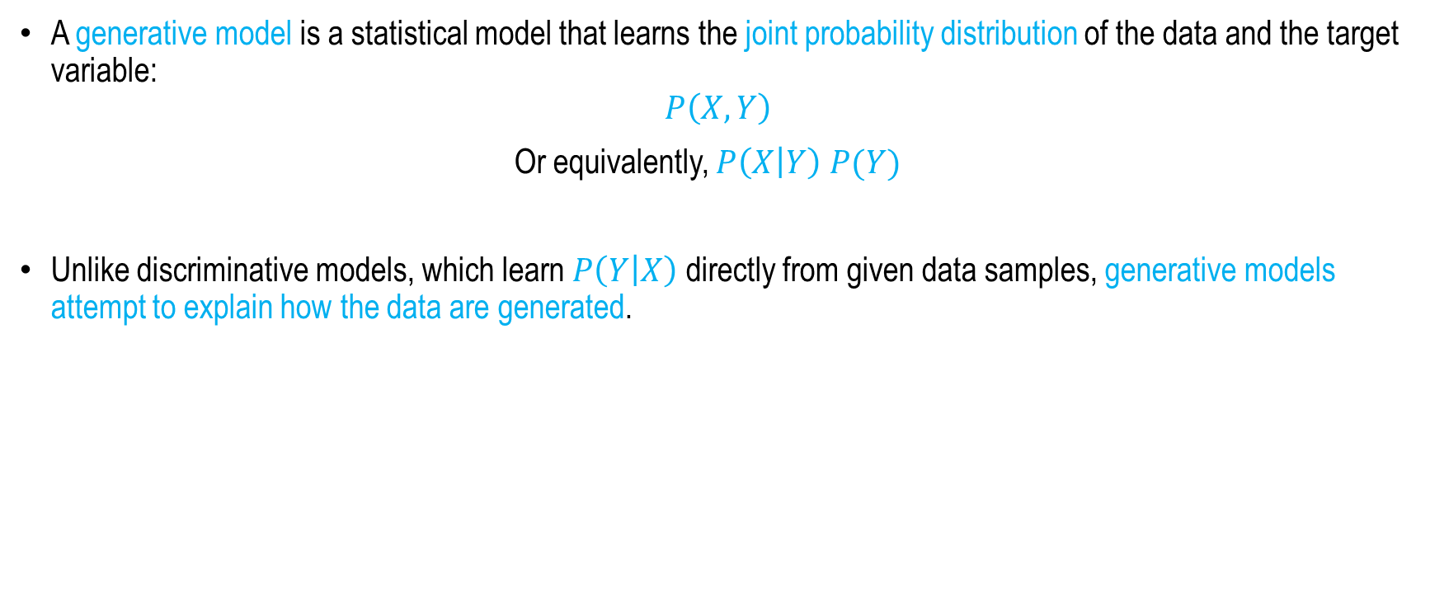
Generative Modelling
A generative model is a statistical model that learns the joint probability distribution of the data and the target variable:
$$P\left(X,Y\right)$$
Or equivalently, $P\left(X | Y\right) P(Y)$
Unlike discriminative models, which learn $P\left(Y | X\right)$ directly from given data samples, generative models attempt to explain how the data are generated.

Slide 18
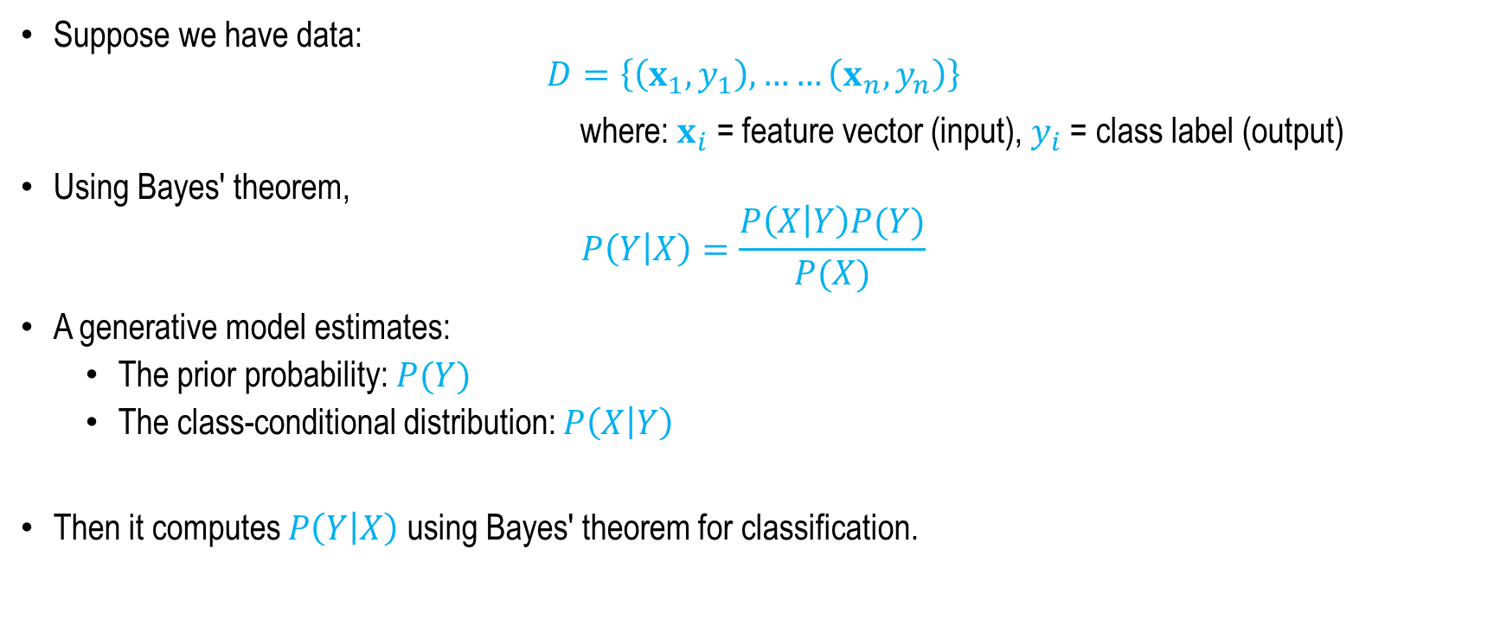
Generative Learning
Statistical Understanding
Suppose we have data:
$$D=\left\{\left(x_{1},y_{1}\right), ……\left(x_{n},y_{n}\right)\right\}$$
where: $x_{i}$= feature vector (input), $y_{i}$= class label (output)
Using Bayes' theorem,
$$P\left(Y | X\right)=\frac{P\left(X | Y\right)P(Y)}{P(X)}$$
A generative model estimates:
  The prior probability: $P(Y)$
  The class-conditional distribution: $P\left(X | Y\right)$
Then it computes $P\left(Y | X\right)$ using Bayes' theorem for classification.

Slide 19
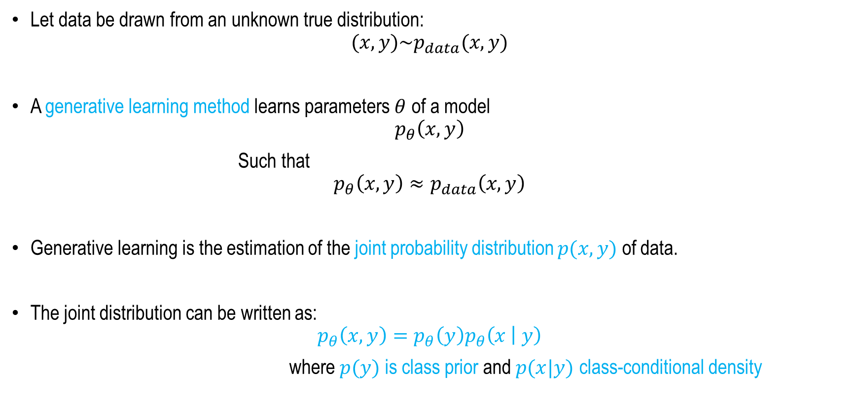
Generative Models (Statistically)
Let data be drawn from an unknown true distribution:
$$(x,y)\sim p_{data}(x,y)$$
A generative learning method learns parameters $θ$ of a model
$$p_{θ}\left(x,y\right)$$
Such that
$$p_{θ}\left(x,y\right)≈p_{data}\left(x,y\right)$$
Generative learning is the estimation of the joint probability distribution $p(x,y)$ of data.
The joint distribution can be written as:
$$p_{θ}\left(x,y\right)=p_{θ}\left(y\right)p_{θ}\left(x | y\right)$$
where $p(y)$ is class prior and $p(x|y)$ class-conditional density

Slide 20
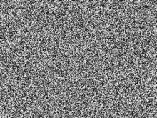

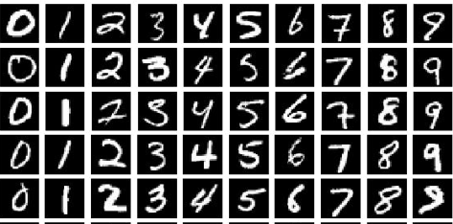
Generative Modelling
Loss (Statistical Distance between D and D’ distributions)
Generator
p(z) ~ Z
Random noise
Generative Model
(Neural Net) G
Generated data
distribution
D’=G(Z)=I’(x)
Real data distribution D=I(x)
In generative modelling, we are given a set of data samples drawn from an unknown real data distribution (D).
The objective is to train a neural network, known as the generator, to learn this underlying distribution and produce a new distribution (D') that closely approximates (D).
The generator takes a randomly sampled noise vector (Z) (also called a latent vector) as input and transforms it into synthetic data samples.
Image: MNIST Dataset

Slide 21
Generative Modelling
Loss (Statistical Distance between D and D’ distributions)
Generator
p(z) ~ Z
Random noise
Generative Model
(Neural Net) G
Generated data
distribution
D’=G(Z)=I’(x)
Real data distribution D=I(x)
During training, the neural network is optimized so that the difference between the real data distribution (D) and the generated data distribution (D') is minimized.
This difference is measured using statistical distance metrics, such as the L1 norm or L2 norm.
As training progresses, the generator gradually learns to produce increasingly realistic samples.
After convergence, the generator can generate new data samples that closely follow the original distribution (D), while being novel and not identical to any of the samples present in the training dataset.
Image: MNIST Dataset

Slide 22
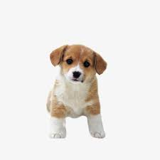
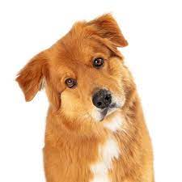
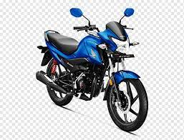
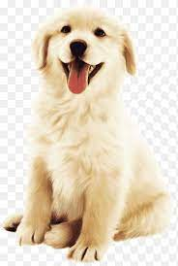
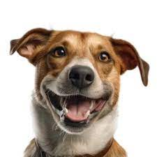
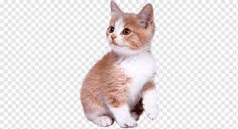
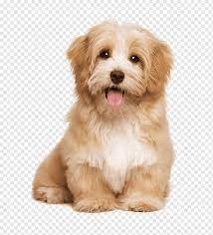
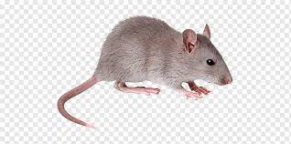
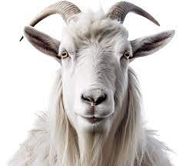
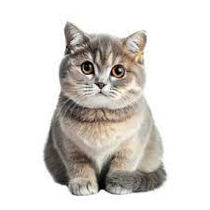
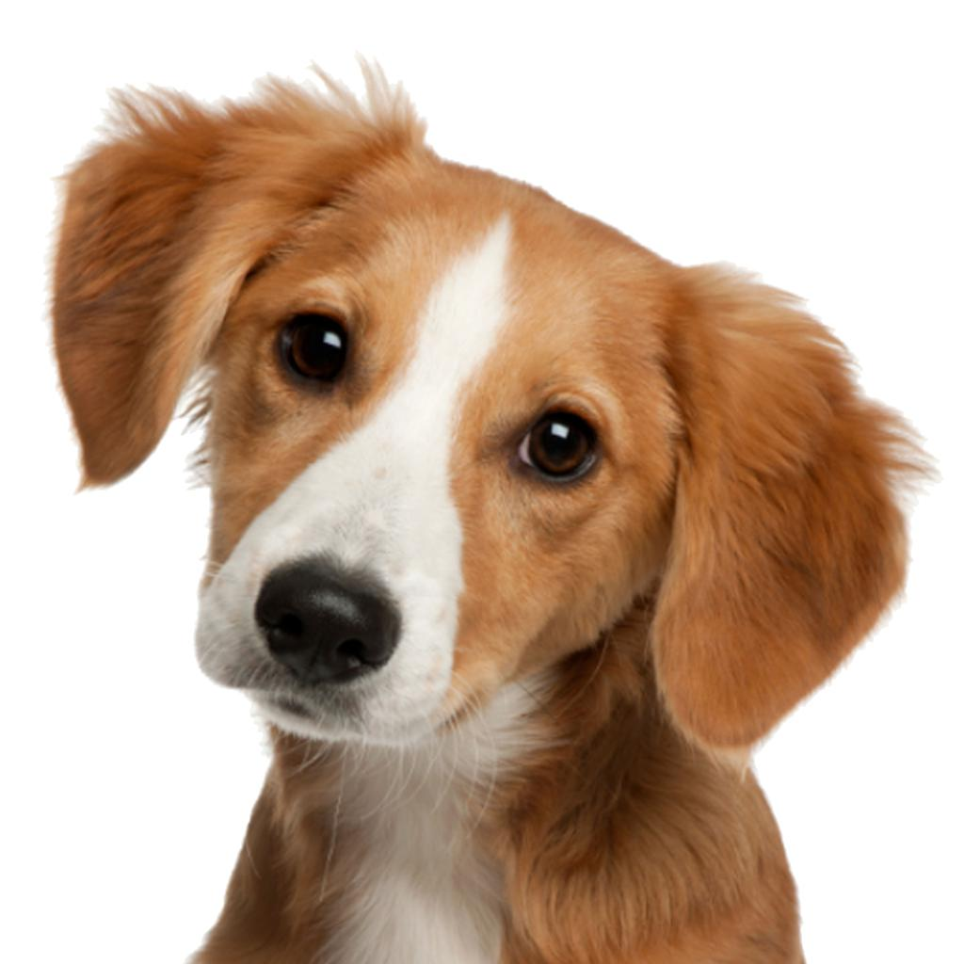
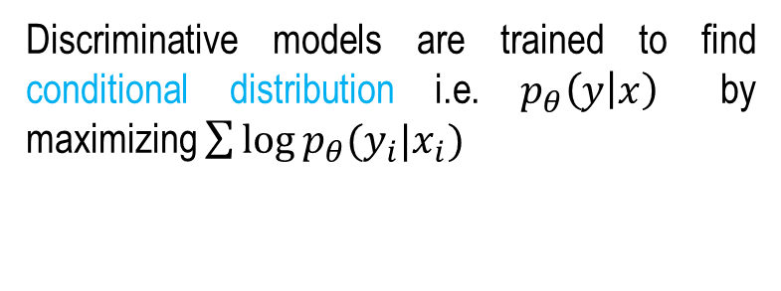
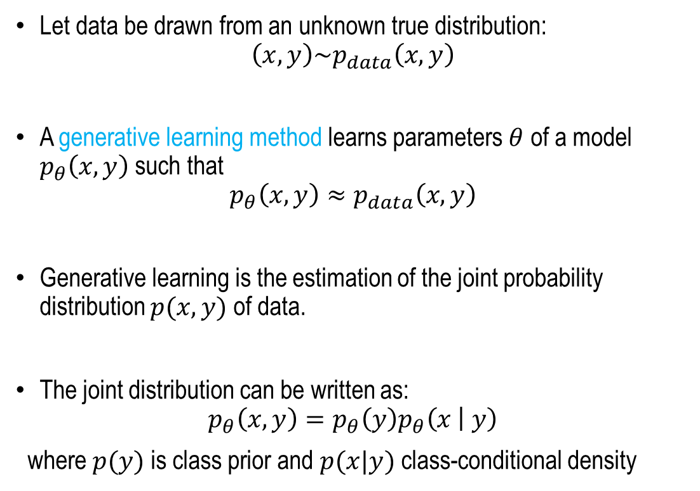
Discriminative vs. Generative
Discriminative models are trained to find conditional distribution i.e. $p_{θ}\left(y | x\right)$ by maximizing $\sum{\log{p_{θ}(y_{i}|x_{i})}}$
Generative models are trained to generate samples from a distribution which is similar to a given distribution. Statistically,
Let data be drawn from an unknown true distribution:
$$\left(x,y\right)\sim p_{data}\left(x,y\right)$$
A generative learning method learns parameters $θ$ of a model $p_{θ}\left(x,y\right)$ such that
$$p_{θ}\left(x,y\right)≈p_{data}\left(x,y\right)$$
Generative learning is the estimation of the joint probability distribution $p(x,y)$ of data.
The joint distribution can be written as:
$$p_{θ}\left(x,y\right)=p_{θ}\left(y\right)p_{θ}\left(x | y\right)$$
where $p(y)$ is class prior and $p(x|y)$ class-conditional density
Dog
Non Dog
P(Y = | X = Dog) = 0.95

Slide 23
Summary
Generative Modelling
Synthetic Data Generation
Discriminative Learning
Generative Learning
Generative vs Discriminative Learning

Slide 24
Generative Vision Models
Next
Lecture 1:Part 3
Generative AI for Computer Vision

